Slide 1
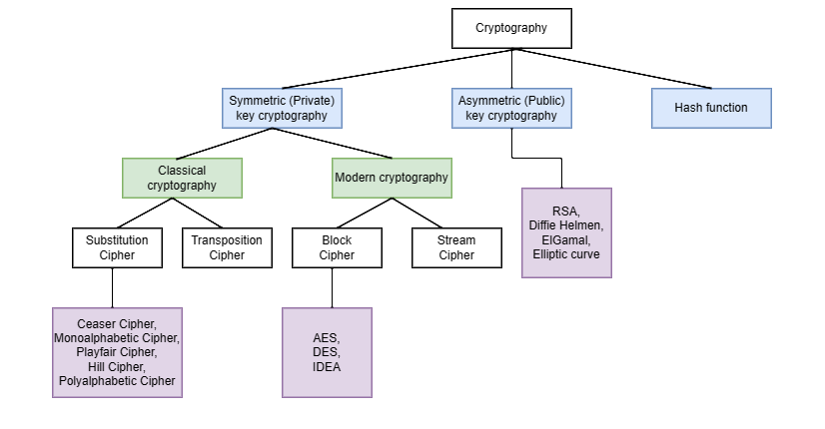
Types

Slide 2
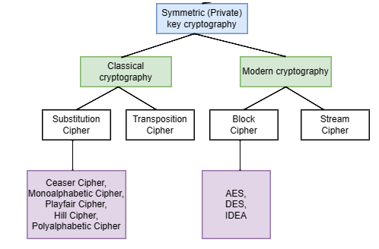
Types

Slide 3
A Definition of Computer Security
The NIST Computer Security Handbook [NIST95] defines the term computer security
as follows:
Computer Security: The protection afforded to an automated information system in order to attain the applicable objectives of preserving the integrity, availability, and confidentiality of information system resources (includes hardware, software, firmware, information/data, and telecommunications)

Slide 4
An original message is known as the plaintext, while the coded message is called the ciphertext.
The process of converting from plaintext to ciphertext is known as enciphering or encryption; restoring the plaintext from the ciphertext is deciphering or decryption.
The many schemes used for encryption constitute the area of study known as cryptography. Such a scheme is known as a cryptographic system or a cipher.
Techniques used for deciphering a message without any knowledge of the enciphering details fall into the area of cryptanalysis.
Cryptanalysis is what the layperson calls “breaking the code.” The areas of cryptography and cryptanalysis together are called cryptology.

Slide 5
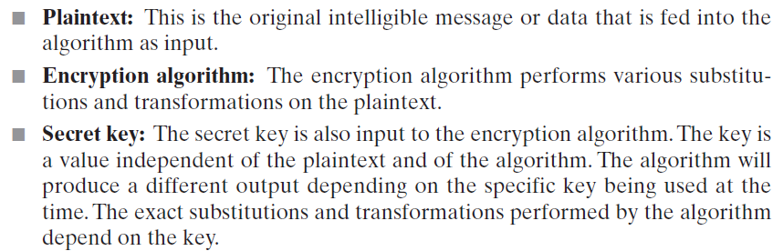
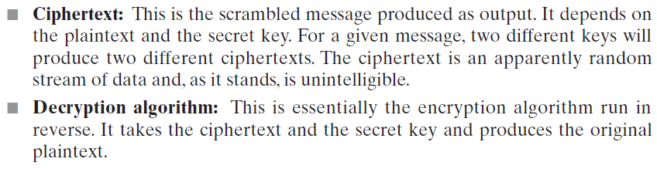

Slide 6
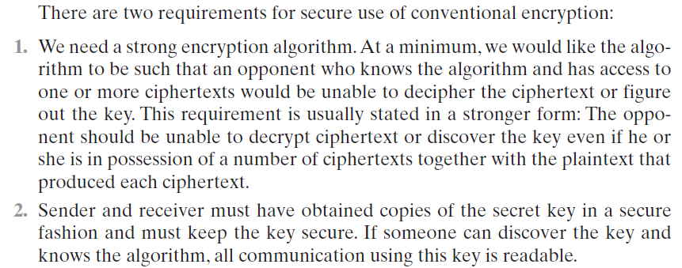

Slide 7
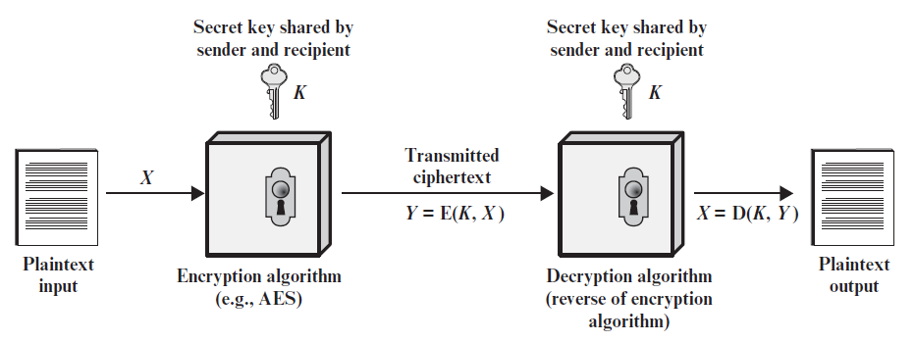

Slide 8
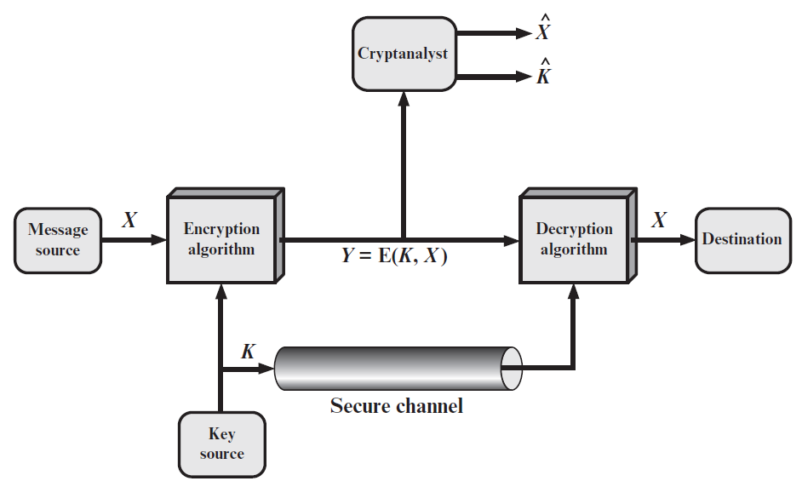

Slide 9
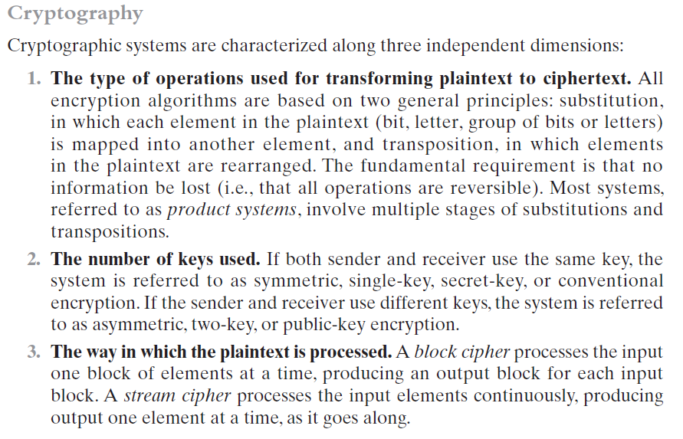

Slide 10
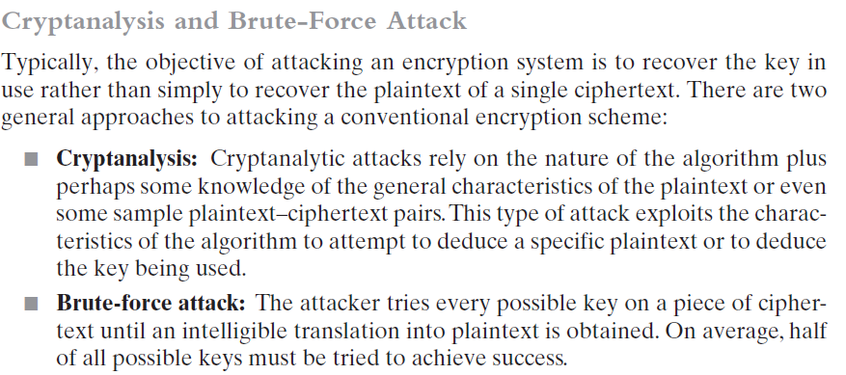

Slide 11
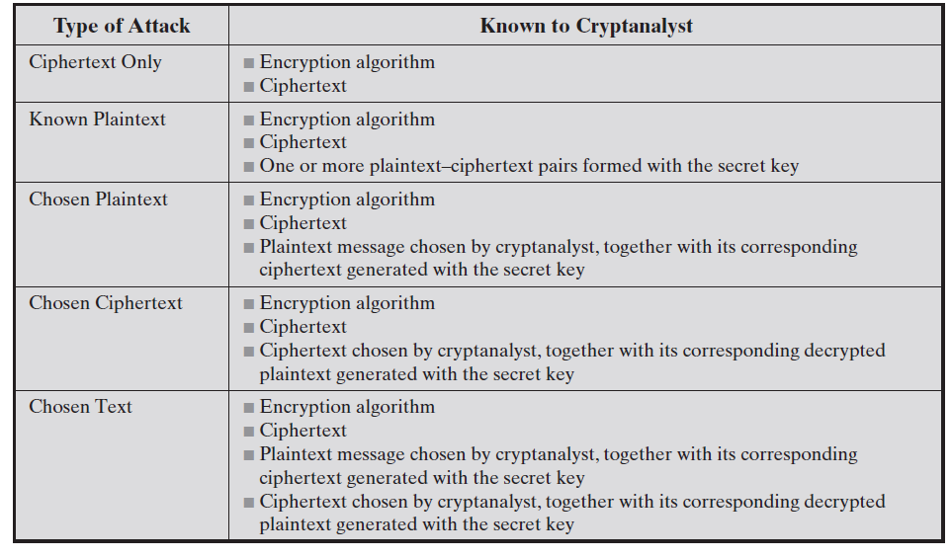

Slide 12
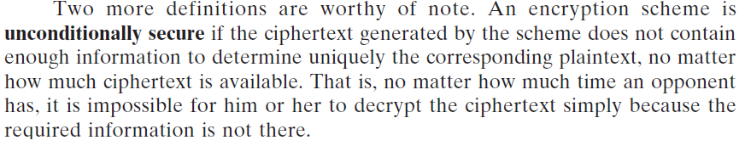
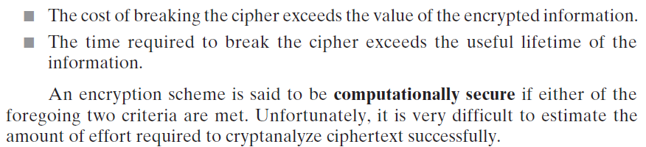

Slide 13
Classical Cryptography
Substitution Ciphers:
Ceaser Cipher
Monoalphabetic Cipher
Playfair Cipher
Hill Cipher
Polyalphabetic Cipher
Transposition Ciphers:
Rail Fence
Row column Transposition

Slide 14
(a) Substitution Ciphers
Letters of plaintext are replaced by other letters or by numbers or symbols or if plaintext is viewed as a sequence of bits, then substitution involves replacing plaintext bit patterns with ciphertext bit patterns.
Ceaser Cipher
Monoalphabetic Cipher
Playfair Cipher
Hill Cipher
Polyalphabetic Cipher

Slide 15
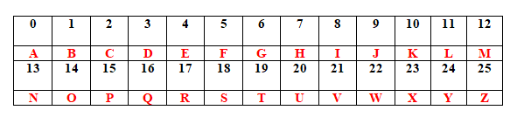
(a.1). Caesar Cipher
The earlier known and simplest substitution cipher by Julius Caesar.
Letters are replaced by other letters or symbols.
Replacing each letter of alphabet with letter standing three places further down the alphabet.
Example:
Notes:
Each alphabet is assigned with the number starting form 0.

Slide 16

Example (Contd....)
Encrypt “neso academy” using Caesar cipher.
Solution:
Notes:
C = (p+k) mod 26
Consider p = n and the letter equivalent to 16 in the table is q.
C = (13+3) mod 26 = 16 mod 26 = 16
Letter equivalent to 16 in the table is q.

Slide 17
Exercise
Decrypt “QHWZRUN VHFXULWB” using Caesar cipher.

Slide 18
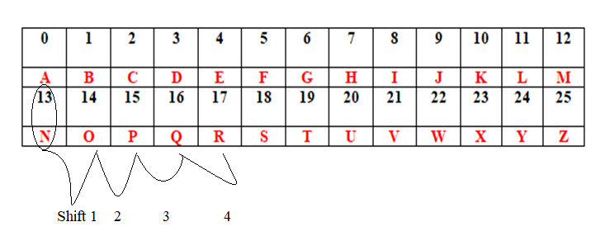
Shift cipher
Key = 2,3,4,…………
Shift cipher with key = 3 is called as Caesar cipher.
Example:
Plaintext: neso
Key: 4
Ciphertext: RIWS

Slide 19
Pros and Cons of Caesar cipher
Pros:
Simple
Easy to implement
Cons:
The encryption and decryption algorithms are known.
There are only 25 keys to try. (Vulnerable to Brute force attack).
The language of the plaintext is known and easily recognizable.

Slide 20
Exercise
Encrypt the plaintext “crytography” using shift cipher (key = 4).
Encrypt “neso” using shift cipher (key = 0).

Slide 21
(a.2) Monoalphabetic Cipher
The ‘cipher’ line can be any permutation of the 26 alphabetic characters.
Permutation:
A permutation of a finite set of elements ‘S’ is an ordered sequence of all the elements of ‘S’, with each element appearing exactly once.
Example:
S = {a,b,c}
There are six permutations of S
abc
acb
bac
bca
cab
cba
There are (3!) 6 possible combinations
Notes:
With only 25 possible keys, the Caesar cipher is far from secure. A dramatic increase in the key space can be achieved by allowing an arbitrary substitution, where the translation alphabet can be any permutation of the 26 alphabetic characters.
See example translation alphabet, and an encrypted message using it.

Slide 22
Each plaintext letter maps to a different random ciphertext letter.
Rather than just shifting the alphabet, this could shuffle (jumble) the letters arbitrarily.
No uniform key difference between the plaintext and ciphertex, it can be permutation.
Eliminate brute-force techniques for cryptanalysis.
Nature of plain text is known because the language used is English.

Slide 23
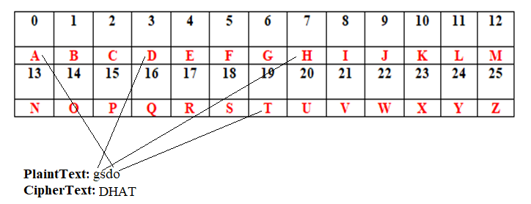
Example
Notes:
We can randomly map it to any letter even a permutation is allowed.
The difference b/w the p.txt and c.txt is not uniform unlike shift cipher and caesar cipher.

Slide 24
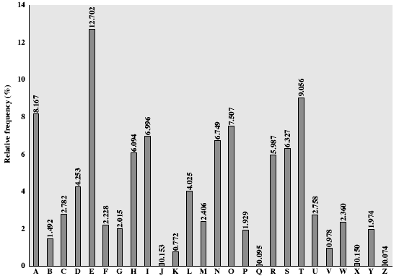
Drawback with the nature of the language.
Relative frequency of English letter

Slide 25
Pros and Cons
Pros:
Better security than Caesar cipher.
Cons:
Easy to break because they reflect the frequency data of the original alphabet.
Prone to guessing attack using the English letter frequency of occurrence of letters.
A countermeasure is to provide multiple substitutes, know as homophones, for a single letter.

Slide 26
(a.3) Playfair Cipher
Aka Playfair square or Wheatstone-Playfair cipher.
Invented in 1854 by Charles Wheatstone.
Manual symmetric encryption technique i.e same key is used for both encryption & decryption.
Digram substitution technique.
Notes:
Lord playfair for promoting its use.

Slide 27
Rules
Rules to create 5 x 5 key matrix (or) playfair square:
Playfair square is filled row-by-row, starting with the keyword followed by the rest of the alphabet.
‘J’ and ‘I’ placed in the same cell of key matrix.
No repeating letters in key matrix.
Rules to prepare message:
Digrams – split the plaintext into pairs.
Split all duplicate letters by inserting filler letter ‘X’.
If there is an odd letter at the end of the message, insert filler letter ‘X’.
Ignore all spaces.

Slide 28
Rules
Rules to encrypt message:
If the pairs are in same row:
Move each letter |→| right one.
Up on reaching end of the table, wrap around.
If the pairs are in same column:
Move each letter |↓| down one.
Up on reaching end of the table, wrap around.
If the pairs forms a rectangle:
Swap |↔|the letters with the ones on the end of the rectangle.
Rules to decrypt message:
If the pairs are in same row:
Move each letter |←| left one.
Up on reaching end of the table, wrap around.
If the pairs are in same column:
Move each letter |↑| up one.
Up on reaching end of the table, wrap around.
If the pairs forms a rectangle:
Swap |↔|the letters with the ones on the end of the rectangle.

Slide 29
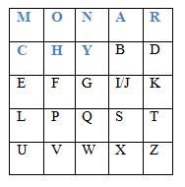
Playfair Matrix (or) Key Matrix
5 x 5 matrix constructed using a keyword Example: Monarchy
Notes:
Lord playfair for promoting its use.

Slide 30
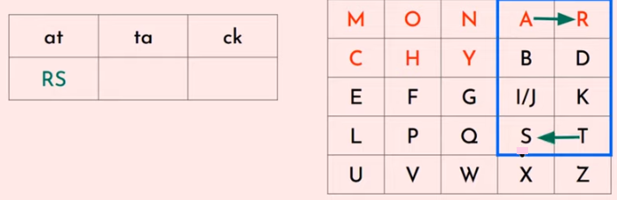
Example - 1
Given;
Key: MONARCHY
PlainText: attack
Digrams: at ta ck

Slide 31
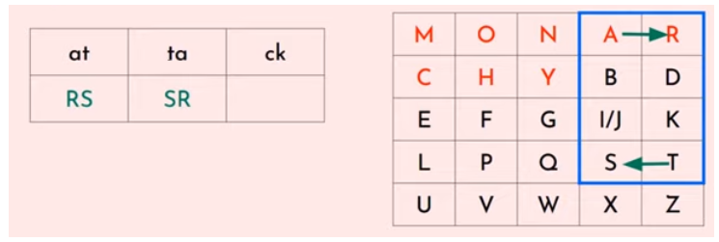

Slide 32
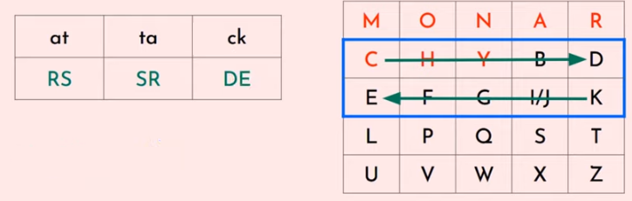
PlainText: attack
CipherText: RSSRDE

Slide 33
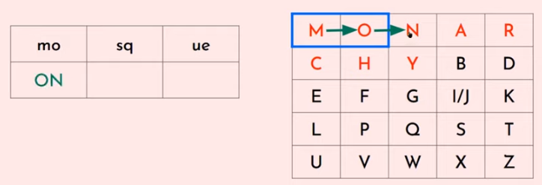
Example - 2
Plaintext: mosque

Slide 34
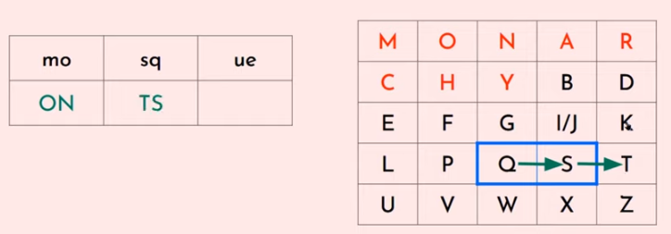

Slide 35
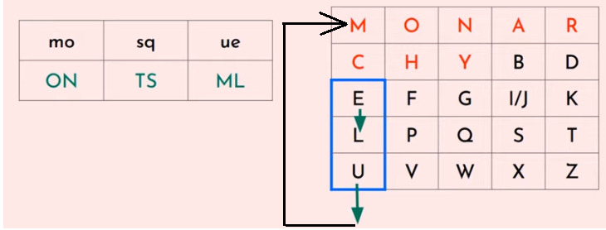
PlainText: mosque
CipherText: ONTSML

Slide 36
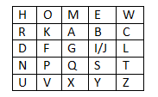
Exercise
A Playfair cipher is given by its key
Encrypt the plaintext: COMEQUICKLYWENEEDHELP
Decrypt the cryptotext: EWWSDSLQHPLIWNFWUNHP

Slide 37
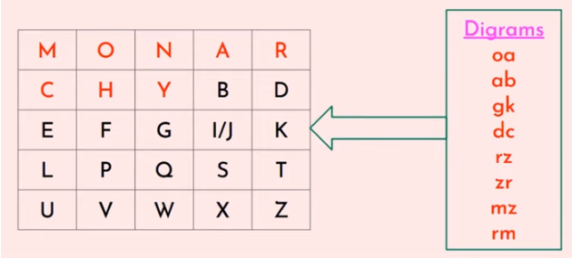
Exercise

Slide 38
(a.4). Hill Cipher
Encrypt group of letters such as digrams, trigraphs, polygraphs.
Developed by Lester Hill in 1929.
Encrypts a group of letters: digraph, trigraph, or polygraph.

Slide 39
Review few terminologies from linear algebra
Concepts to be known:
Matrix arithmetic modulo 26.
Square matrix (no.of rows = no.of columns).
Determinant.
Multiplicative inverse.

Slide 40
Hill Algorithm
Encryption:
C = E (K,P) = P x K mod 26
Decryption:
P = D (K,C) = C x K⁻¹ mod 26.

Slide 41
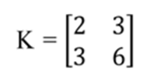

Example – Encryption
Given; Plain Text = ATTACK, and key
Step1: Key matrix must be a square matrix.
Ex: Consider the key
Step2: Divide the plain text into a vector component , where the size is based on key size.
If the key size is 2x2, then consider the vector of length 2, if the size is 3x3, then consider the vector of length 3, and so on.
Ex: consider the plain text P = ATTACK, then the vector component will be;

Slide 42
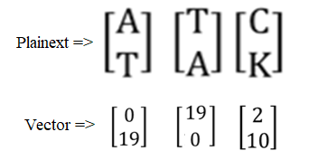
Step3: Assign numerical equivalent to each letters in plain text.
Ex:

Slide 43
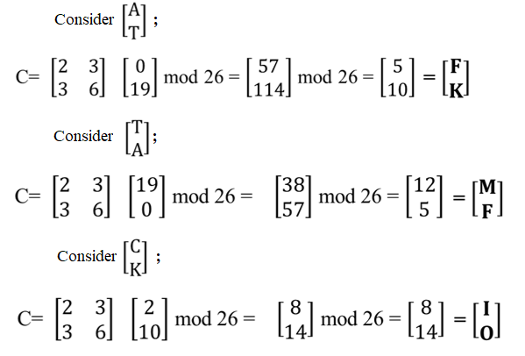
Step4: Convert the cipher text using the following;
C = E (K,P) = P x K mod 26
Plain Text: ATTACK
Cipher Text: FKMFIO

Slide 44
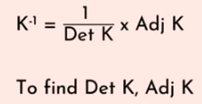
Decryption in Hill cipher
Decryption:
P = D (K,C) = C x K⁻¹ mod 26
Decryption requires K⁻¹ ,the inverse matrix K

Slide 45



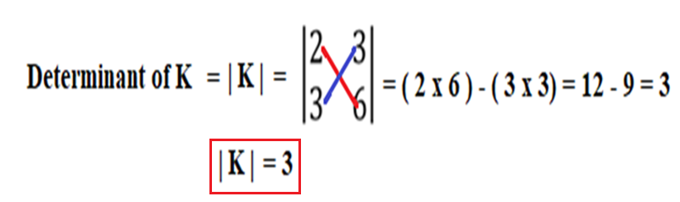
Example – Decryption
Step1: Consider , where
Step2: Find determinant of K
NOTE:

Slide 46
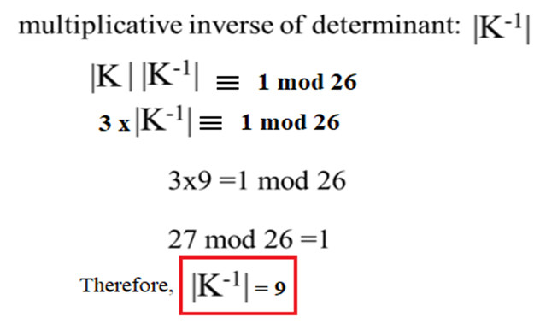
Step3: Find multiplicative inverse of |K|

Slide 47
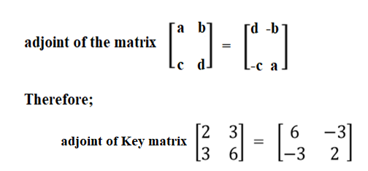
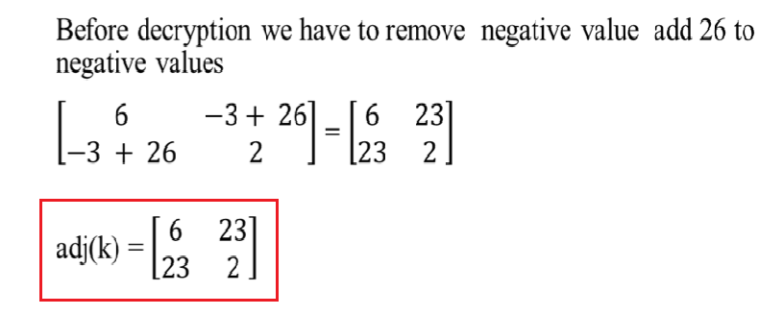
Step4: Find adjoint of K

Slide 48

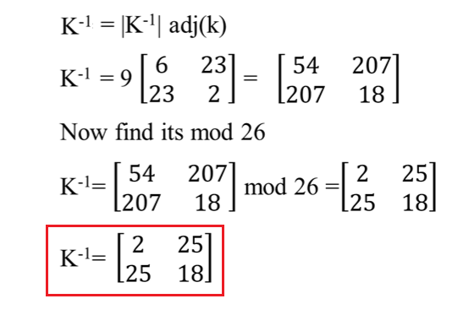
Step 5:

Slide 49

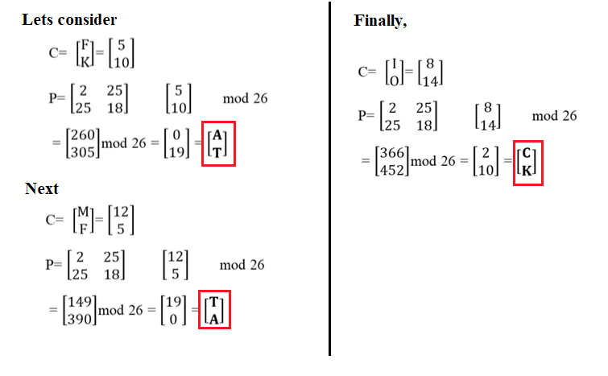
Step6 : Now we will decrypt using
Plain Text = ATTACK

Slide 50
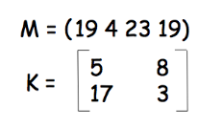
Exercise
Consider the following plaintext (M) and key matrix (K), encrypt the message using Hill-Cipher.

Slide 51
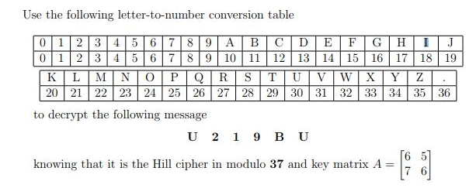
Exercise

Slide 52
(a.5). Polyalphabetic Ciphers
To improve on the simple monoalphabtic technique.
Features:
Symbol in plaintext is mapped to multiple substitution alphabets.
The relationship between a character in the plain text and the characters in the cipher text is one to many.

Slide 53
Vigenere Cipher
It consists of the 26 Caesar ciphers with shifts of 0 through 25.
Encryption process:
C_{i} = (P_{i} + K_{i mod m} ) mod 26
Where C_{i} is the cipher text at i^{th} position.
Decryption process:
P_{i} = (C_{i} - K_{i mod m} ) mod 26
Where P_{i} is the plain text at i^{th} position.

Slide 54
Example
Given;
PlainText: wearediscoveredsaveyourself
Key: deceptive
Encryption Process:
Step1: Repeat the key as long as plaintext gets extended.
PlainText: wearediscoveredsaveyourself
Key: deceptivedeceptivedeceptive

Slide 55
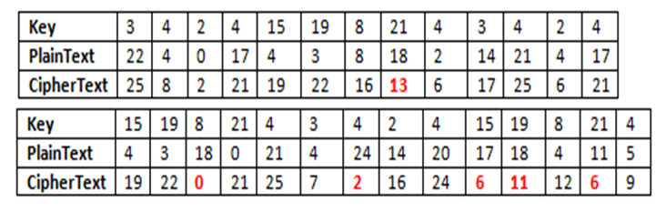

Step2: Assign numerical equivalent to each letters in the key and plain text.
Then use C_{i} = (P_{i} + K_{i mod m} ) mod 26
Step3: Replace the numbers in CiperText with associated alphabet.
PlainText: wearediscoveredsaveyourself
CipherText: ZICVTWQNGRZGVTWAVZHCQYGLMGJ

Slide 56
Vigenere cipher - Cryptanalysis
Determining the length of the keyword.
Key and the plaintext share the same frequency distribution of letters, a statistical technique can be applied.

Slide 57
Auto key system
The periodic nature of the keyword can be eliminated by using a non-repeating keyword that is as long as the message itself.
Vigenere proposed autokey system, in which a keyword is concatenated with the plaintext itself to provide a running key.
Example:
PlainText: wearediscoveredsaveyourself
Key: deceptivewearediscoveredsav
Vigenere proposed autokey system, in which a keyword is concatenated with the ciphertext itself to provide a running key.

Slide 58

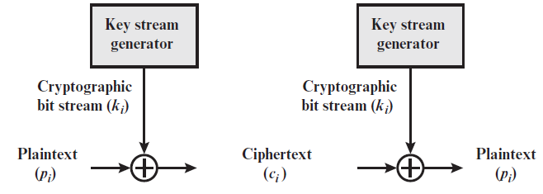


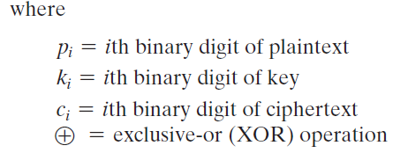
Vernam Cipher

Slide 59
